Slide 1
Introduction to IOS

Slide 2
What is IOS?
Internetwork Operating System (IOS) is the Cisco Devices Operating System (Just like Microsoft Windows ® For PC)

Slide 3
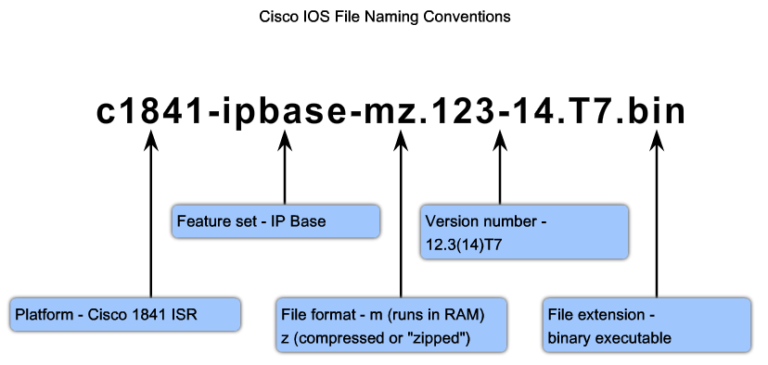
What is IOS?

Slide 4
Introduction to IOS 15 CLI Licensing Commands
A. Peter Anderson
Associate Professor
August 4, 2013

Slide 5
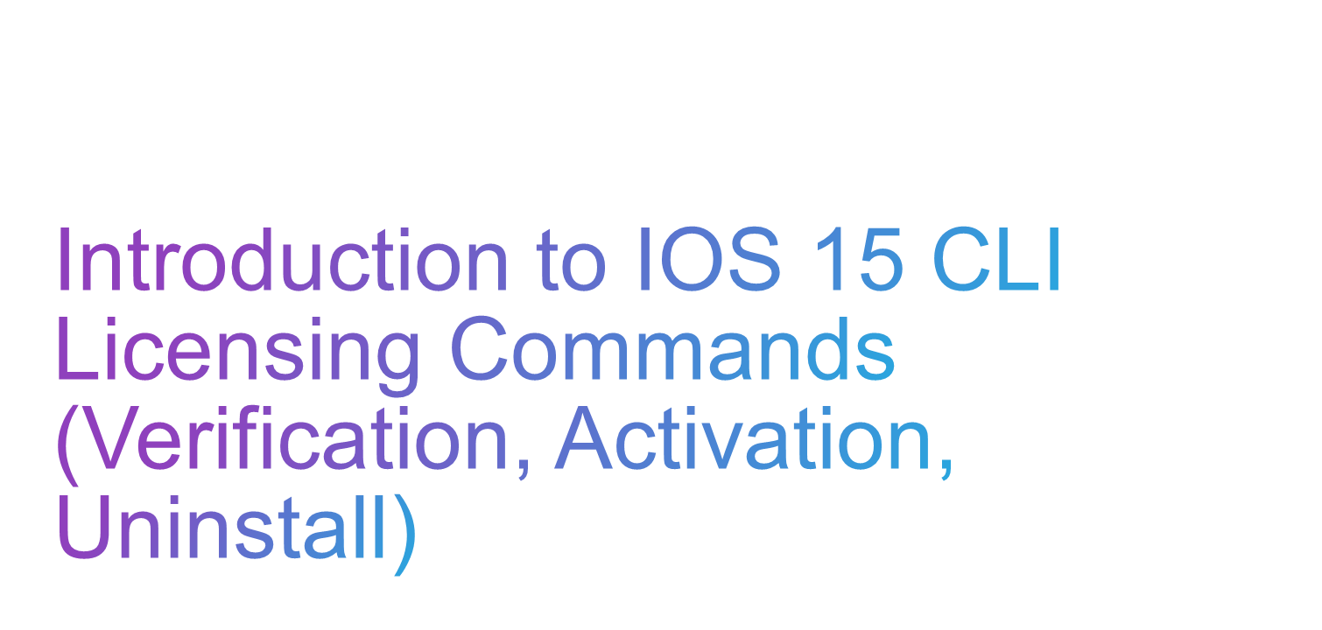

Slide 6

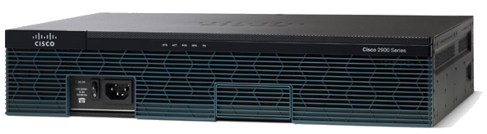
License Management Commands
Display License Info
Enable / Disable Technology Package Licenses
Additional Resources:
  Cisco IOS Software Activation Command Reference
  Software Activation Configuration Guide, Cisco IOS Release 15M&T
Yes Officer, I have a License.
Notes:
New section:

Slide 7

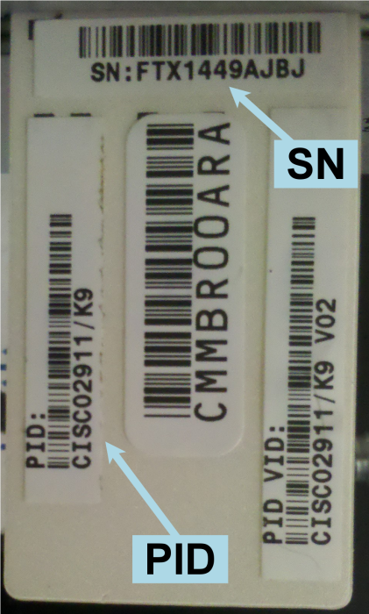
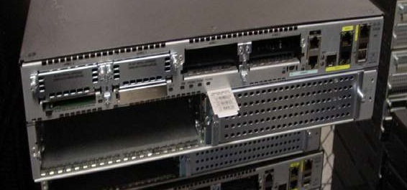
Command: show license udi
Displays all the unique device identifier (UDI) values that can be licensed on the system
Notes:
The locations to find UDI information on the router
CLI command: show license udi
CLI command: show version
On the plastic tab directly attached to the router
This information is needed to purchase upgrades at a later time, transfer licenses, and lookup licenses.

Slide 8
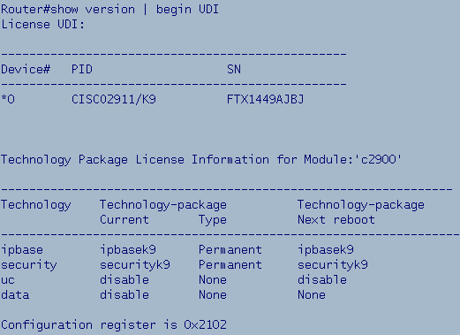
Command: show version
Displays the hardware and Technology Package License information.
Determine Technology license Type.
Determine Technology license status at Next Boot.
Determine Technology Package Status.
Notes:
Show version now has additional information pertaining to licensing. Several ways to show this data.
Allows the identification of:
Current Technology Package Status.
Current Technology Package License Type.
Technology Package License Status at Next Boot.

Slide 9
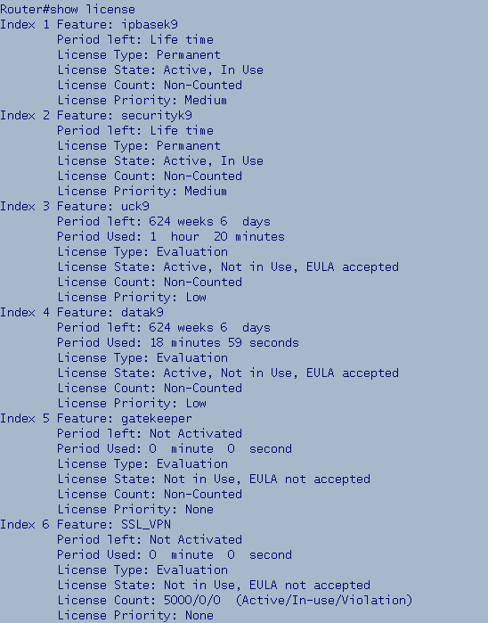
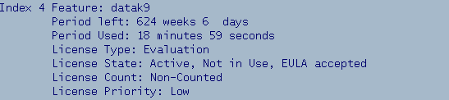
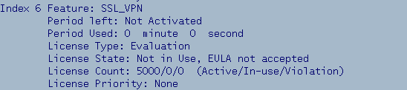
Command: show license
Displays detailed information
about all feature licenses.
Type of license
  Evaluation or Permanent
Actual usage time of the license
  Time used and left in the evaluation
Notes:
Shows all feature licensing. Technology & Feature inclusive.
First animation: ipbasek9 has permanent license, no expiration date
Screen below shows that the temporary data Technology License has been used for 18min 59 sec.
Other show license commands:
show license all
show license detail

Slide 10
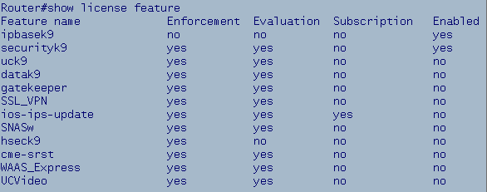
Command: show license feature
Lists the available licenses on the device
Lists the status of the licenses
Notes:
Displays the current list of all features on the router & which are enabled.

Slide 11
Activate/Deactivate Technology Package Licenses
Available Technology Package Licenses:
  Data, Unified Communications and Security
Enable:
Router(config)# license boot module C2900 technology-package datak9
<Model> <Package>
Disable:
Router(config)# no license boot module C2900 technology-package datak9 [disable]
  OR
Notes:
Before activating a license (if you want it to be permanent) you need to upload the license (.lic) file to flash.
To Enable: license boot module <Model> technology-package <Package>
To Disable: no license boot module <Model> technology-package <Package> OR
license boot module <Model> technology-package <Package> disable

Slide 12
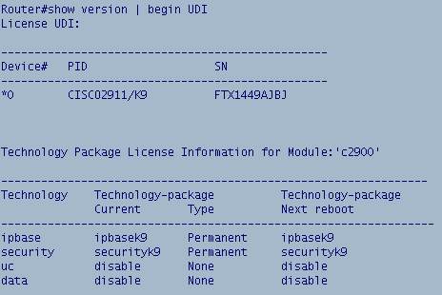

Verifying A Technology Package License
  Step 1: Issue show version | begin UDI (verify data license is disabled)
Notes:
This command is issued to verify that the Technology Package is not enabled already!

Slide 13
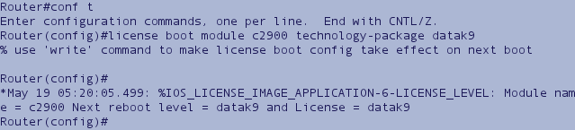
Activating A Technology Package License
  Step 2: Activate the data technology package license
  Router(config)# license boot module c2900 technology-package datak9
Notes:
Note the output after issuing the license boot module command:
Issue the “write” or “do write” command
Technology Package will be active after next Router Reboot
Issue the show version | begin UDI command to verify

Slide 14
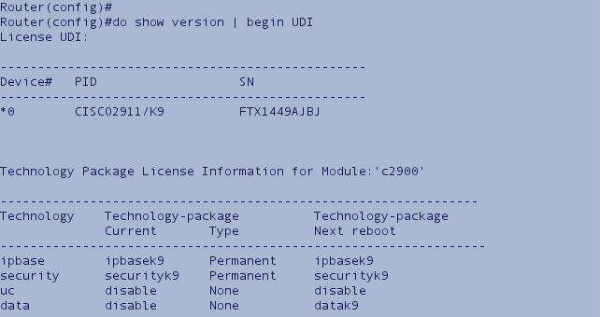

Verify A Technology Package License Status after Next Reboot
Step 3: Verify activated license:
  Router(config)# do show version | begin UDI
Notes:
Verify that after the next router reboot the “Data” Technology Package will be Active.

Slide 15
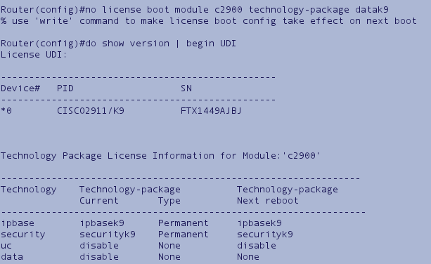

Uninstalling A Technology Package License
  Step 1: no license boot module c2900 technology-package datak9 OR
  license boot module c2900 technology-package datak9 disable
  Step 2: show version | begin UDI to verify that the license is disabled
Notes:
Note that there are two ways to disable a Technology Package:
no license boot module <Model> technology-package <Package>
OR
license boot module <Model> technology-package <Package> disable

Slide 17
Overview of IOS 15 Licensing and Process
A. Peter Anderson
Associate Professor
August 4, 2013

Slide 18
Introduction to Licensing
Notes:
It is important to note that IOS 15 licensing is enforced by activation on ISR G2 devices and by “honor code” on ISR G1 devices.
ISR G1’s don’t require licensing, they go off of the “honor code”, future releases are no longer supported. No UID is needed, if you purchased the IOS it can be loaded onto the device and used without activation.

Slide 19
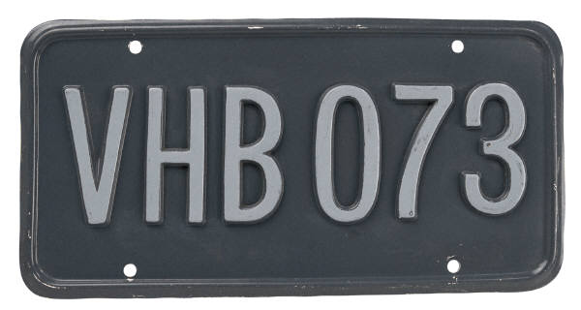
Available License Types on ISR G2
Permanent Licenses
Evaluation Licenses
Feature Licenses:
  Software Activation Feature Licenses
  Right to Use Feature Licenses
Subscription Licenses
Counted Licenses
Notes:
There are two major types of licenses:
Permanent
Evaluation
There are three minor types of licenses:
Feature
Subscription
Counted

Slide 20


A Permanent License never expires.
Once a permanent license is installed on a router, it is good for that particular feature set for the life of the router even across IOS versions. For example, once a UC, Security or Data license is installed on a router, the subsequent features for that license will be active even if the router is upgraded to a new IOS release.
A permanent license is the most common license type used when a feature set is purchased for a device.

Slide 21



A Evaluation License is good for a limited amount of time.
ISR G2 includes a full set of 60 day Evaluation License(s) for the Data, UC and Security feature sets.
These can be activated and deactivated at any time to evaluate a feature set before making the decision to convert to a Permanent License.
They also provide a mechanism that gives the user some flexibility before upgrading to a Permanent License.
Only the time a Evaluation License is active counts against the 60 day allotted time.
Once an Evaluation License expires, it cannot be extended.
Notes:
Evaluation Licenses – Allow you to test drive features & verify they’re in that pak before permanently buying.
Evaluation Licenses – Indirectly has helped implementation practices, for example, if we purchased the wrong code, no problem – we have time to purchase it and in the meantime still implement the proper configuration.
Real problem with IP base for switching (EIGRP stub)

Slide 22

Software Activation Feature Licenses
  Typically upgrades to one or more technology Package Licenses (Data, UC or Security)
  Can be delivered with new router or upgraded at a later time.
  Licenses are enforced through Cisco Software Licensing framework
Right to Use Feature Licenses
  Does not require software activation (honor system)
  Can be ordered with new router or upgraded at a later time.
Notes:
Software Activation
Adds a feature which requires an additional license in addition to the technology package.
Cisco Software Licensing Framework – The policing & admin function implemented by Cisco to enforce licensing.
Right to Use Licenses
A Right to Use license scheme is an honor-based model for licensing. Licenses are not tied to an unique device identifier (UDI), product ID, or serial number.
Therefore, if you want to use the feature, nothing is stopping you, but you are expected to have purchased the technology package even though its not enforced through a license.
Software Activation Feature Licenses:
Technology Packages: IPBase, Security, Data, UC
Intrusion Prevention (Subscription)
Content Filtering (Subscription)
SSLVPN (Counted)
SNA Switching
Gatekeeper
CUE (Counted)
Right to Use Feature Licenses:
Land Mobile Radio
VXML Gateway (Counted)
CME (Counted)
SRST (Counted)
CUBE (Counted)

Slide 23

May be Software Activation or Right-to-Use Feature Licenses
Subscription Licenses
  Time-based licenses
  Software Activation Feature Licenses - Intrusion Prevention, Content Filtering
Counted Licenses
  Enable a defined number of users
  Software Activation Feature Licenses – SSLVPN, CUE
  Right-to-Use Feature Licenses – VXML, CME, SRST, CUBE
Notes:
Software Activation Feature Licenses:
Technology Packages: IPBase, Security, Data, UC
Intrusion Prevention (Subscription)
Content Filtering (Subscription)
SSLVPN (Counted)
SNA Switching
Gatekeeper
CUE (Counted)
Right to Use Feature Licenses:
Land Mobile Radio
VXML Gateway (Counted)
CME (Counted)
SRST (Counted)
CUBE (Counted)

Slide 24
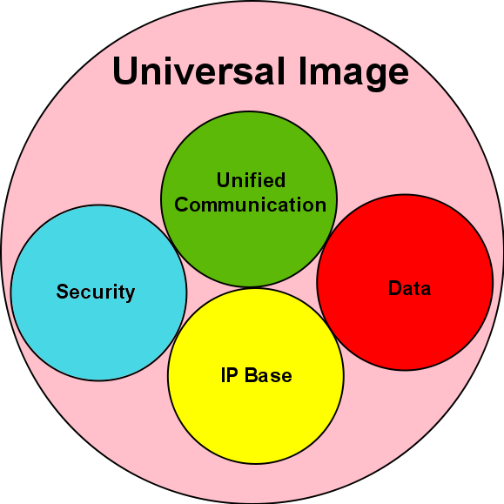
Technology Package Licenses
Technology Package Licenses (Permanent/Evaluation)
  IP Base (Permanent Only)
  Security
  Data
  Unified Communication

Slide 25
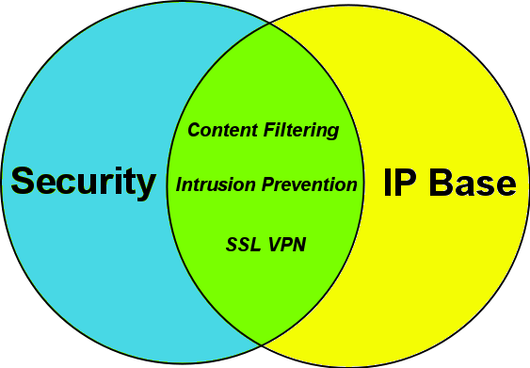
Technology Package License: Security
Security Technology Package License activated:
  Additional Software Activation Feature Licenses
    Intrusion Prevention (Subscription)
    Content Filtering (Subscription)
    SSL VPN (Counted)
Notes:
Example: If you needed Intrusion Prevention, you’d have to purchase the Security Technology PAK license first, then you could add (for a cost) the Intrusion Prevention Subscription.

Slide 26
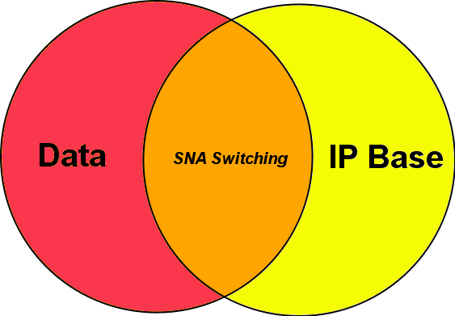
Technology Package License: Data
Data Technology Package License activated:
  Additional Software Activation Feature License
    SNA (Systems Network Architecture) Switching

Slide 27
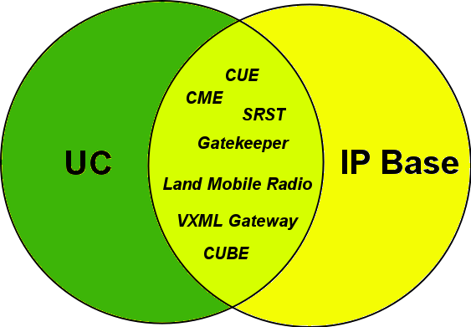
Technology Package License: UC
Unified Communication Technology Package License activated:
  Additional Software Activation Feature Licenses
    Gatekeeper
    CUE (Counted)
  Additional Right to Use Feature Licenses
    Land Mobile Radio
    VXML Gateway (Counted)
    CME (Counted)
    SRST (Counted)
    CUBE (Counted)
Notes:
Example: Similar to purchasing MS Exchange Server (that would be the UC Tech Package here)
Then you need to buy additional Client licenses (that would be like enabling the CME here)

Slide 28
Licensing Process
Step 1: Purchase the Software Package or Feature to Install
  A Product Authorization Key (PAK) will be provided upon payment
    Acts as a Receipt
    Used to obtain a license
Step 2: Obtain A License file
  Option 1 -Cisco License Manager, which is a free software application available at http://www.cisco.com/go/clm.
  Option 2 -Cisco License Registration Portal: www.cisco.com/go/license
  An e-mail containing the license information that you can use to install the license is received
Step 3: Install the License
  Copy the license file received to the appropriate file system on the device

Slide 30
Introduction to IOS 15 Trains, Numbering, and System Image Packaging
A. Peter Anderson
Associate Professor
August 4, 2013

Slide 31
Universal IOS Image
Notes:
One of the major differences between IOS releases prior to 15 and IOS 15 releases is the concept of a Universal Image. A universal image contains all of the features capable on the specific device, but may not be activated by default. Additional features may require the purchase of additional licenses to activate.

Slide 32

What is a Universal Image?
Universal IOS Image contains all Cisco IOS features.
Single universal IOS Image is shipped with the ISR G2 devices.
IOS functionality is determined by the specific licenses applied to the devices.
Only two IOS images for each release:
  universalk9: This universal image offers all the Cisco IOS features including strong crypto features such as VPN payload, Secure UC, etc.
  universalk9_npe (no payload encryption): This universal image satisfies requirements of import restricted countries. It does not support any strong payload encryption, such as VPN payload, secure voice, etc.
Examples:
  c2900-universalk9-mz.SPA.151-4.M.bin
  c2900-universalk9_npe-mz.SPA.151.4-M.bin
Notes:
Cuba, Iran, North Korea, Sudan, and Syria. These are Embargoed. Cisco doesn’t ship at all to these Countries.
These are the “Restriction Free” Countries. If you aren’t in this list, Cisco may not be allowed to ship Strong Encryption:
Austria, Australia,
Belgium, Bulgaria, Canada, Cyprus, Czech Republic, Denmark, Estonia, Finland, France,
Germany, Greece, Hungary, Iceland, Ireland, Italy, Japan, Latvia, Lithuania,
Luxembourg, Malta, Netherlands, New Zealand, Norway, Poland, Portugal, Romania,
Slovakia, Slovenia, Spain, Sweden, Switzerland, Turkey, United Kingdom, United States.
Universalk9_npe: npe (no payload encryption)
Include the Short List of Countries Impacted by npe code.

Slide 33

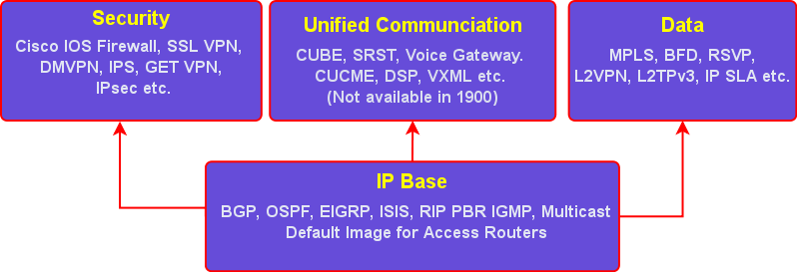
Includes all the available features in a model.
Four technology packages available: IP Base, Security, UC and Data
  IP Base Technology Package is enabled by default.
  Security, UC and Data Technology Package licenses activate more features.
Notes:
IOS 15.0 universal image aims to reduce the complexity when trying to determine the right license, for the right job.
Features not supported from IOS Release 15 onward:
AppleTalk
Cisco Service Selection Gateway (SSG)
SSG is a switching solution for Service Providers who offer Intranet, Extranet and Internet connections to subscribers using broadband access technology such as DSL, cable modems, or wireless LAN
http://www.cisco.com/en/US/products/ps6589/products_ios_protocol_group_home.html

Slide 34
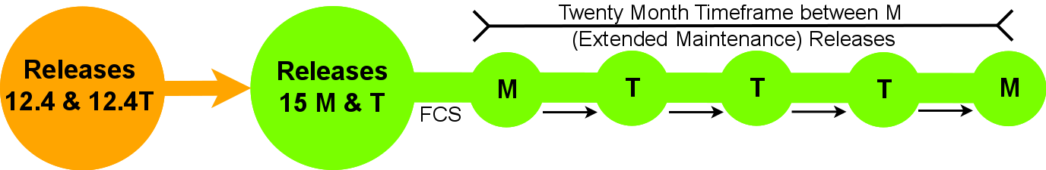
IOS Release 15 Timeline
Feature inheritance and platform support from 12.4T and 12.4 Mainline
Two major maintenance releases for IOS 15:
  M Release (Extended)
  T Release (Standard)
FCS: First Customer Ship
  The date the software release is first available to customers on Cisco Software Download Center
Notes:
Exceptions to the first statement: Appletalk and Cisco Service Selection Gateway (SSG)
FCS: first customer ship (day 0)
The date the software release is first available to customers on Cisco Software Download Center

Slide 35

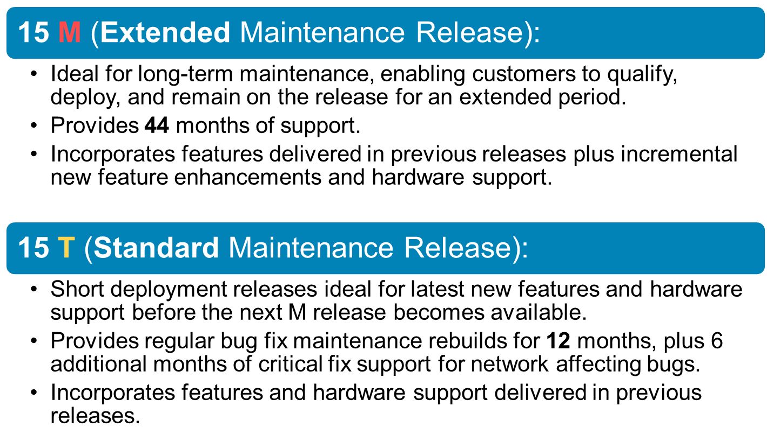
Notes:
T will most likely be used by those who want the latest features (resellers, vendors, students etc.)
M however will most likely be used in production networks, will lag behind T train releases, so hopefully the resellers, vendors and students can learn about the new features prior to deployment.

Slide 36
c2900-universalk9-mz.SPA.151-4.M1.bin
The New IOS 15 Naming Convention
Major Release Number
A.
Minor Release Number
B.
New Feature Release Number
C.
M/T = Ext./Std Maintenance
D.
Maintenance Rebuild Number
E.
Notes:
Ask the audience to name the parts
A. major release number
B. minor release number
C. new feature release number
D.
M = extended maintenance release
T = standard maintenance release
E. maintenance rebuild number
No new features or hardware support are delivered in maintenance rebuilds of release 15 M or T

